Slide 1
Randomized Algorithms CS648A
Mini Projects

Slide 2
Randomized algorithm for Primality

Slide 3


mod operation
$p$ : a prime number
(Fermat’s little theorem)
If $p$is prime then for each $a<p$,
$a^{p−1}mod p=1$.
Question: What if $p$is composite ?
1st Task:
For each $a<p$, $a^{p−1}mod p≠ 1$.
A programming exercise

Slide 4

A programming exercise
For each composite number $n$from $6$ to $1000$,
determine the count of the numbers $a<n$ such that $a^{n−1}mod n≠ 1$
Draw useful inferences.

Slide 5
Randomized QuiCk sort
Concentration of its running time around its expected value

Slide 6

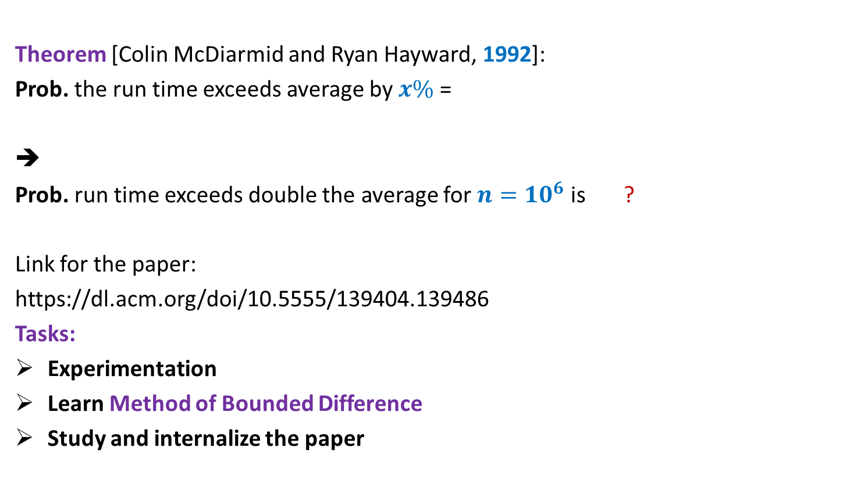

What makes Quick sort popular ?
Theorem [Colin McDiarmid and Ryan Hayward, 1992]:
Prob. the run time exceeds average by $x\%$ =
➔
Prob. run time exceeds double the average for $n=10^{6}$ is ?
Link for the paper:
https://dl.acm.org/doi/10.5555/139404.139486
Tasks:
Experimentation
Learn Method of Bounded Difference
Study and internalize the paper
$$n^{− \frac{x}{100} ln ln n}$$
< $10^{−15}$

Slide 7

Hashing
With worst case $O(1)$ search time

Slide 8

Problem Definition
$U=\left\{1,2,…,m\right\}$ called universe
$S⊆U$ and $s=|S|$
$s≪$ $m$
Examples:
$m={10}^{18}$ , $s={10}^{3}$
Aim
Build a data structure for a given $S$to support the search query :
“Does $i∈$ $S$ ?” for any $i∈U$.

Slide 9


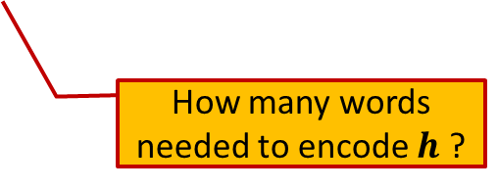
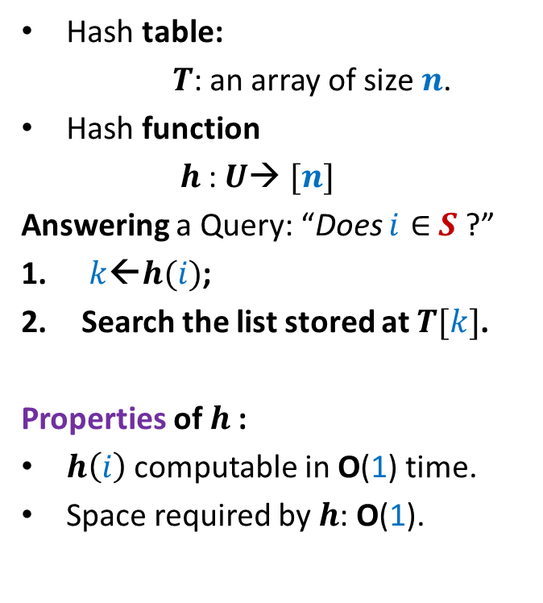

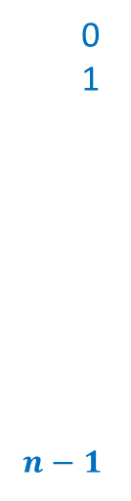

Hashing
Hash table:
$T$: an array of size $n$.
Hash function
$h$: $U$→ $[n]$
Answering a Query: “Does $i∈$ $S$ ?”
$k$←$h(i)$;
Search the list stored at $T[k]$.
Properties of $h$:
$h\left(i\right)$ computable in O(1) time.
Space required by $h$: O(1).
Elements of $S$
$$T$$
0
1
$$n−1$$
$$⋮$$
$$⋮$$
How many words needed to encode $h$ ?

Slide 10
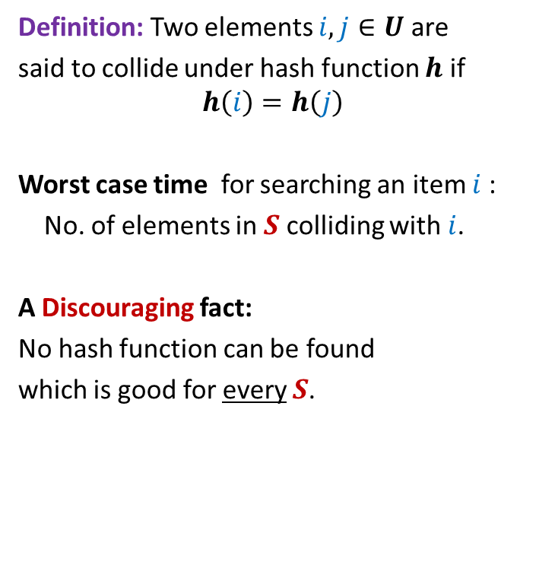
Collision
Definition: Two elements $i,j∈U$ are
said to collide under hash function $h$ if
$$h\left(i\right)=h\left(j\right)$$
Worst case time for searching an item $i$:
No. of elements in $S$ colliding with $i$.
A Discouraging fact:
No hash function can be found
which is good for every $S$.
$$T$$
0
1
$$n−1$$
$$⋮$$
$$⋮$$

Slide 11

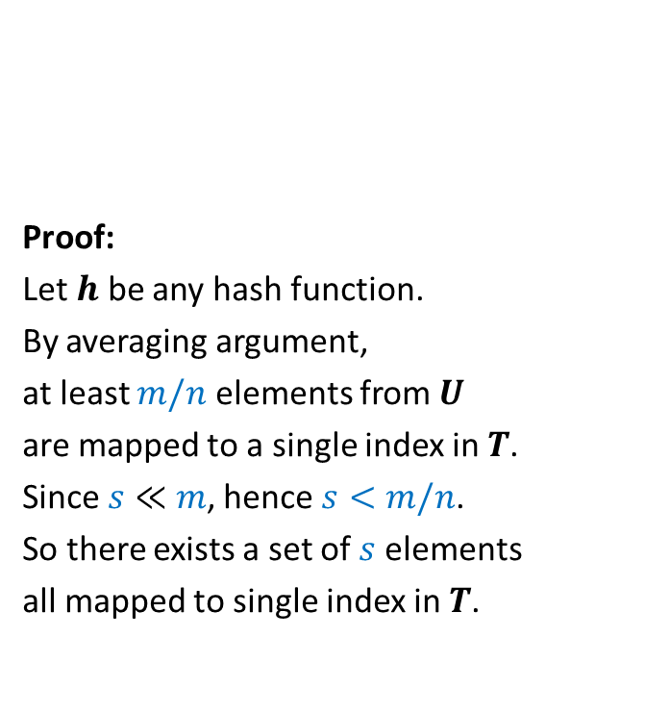
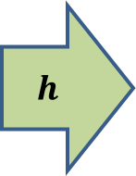


Collision
1
2
Proof:
Let $h$ be any hash function.
By averaging argument,
at least $m/n$ elements from $U$
are mapped to a single index in $T$.
Since $s≪$ $m$, hence $s<m/n$.
So there exists a set of $s$ elements
all mapped to single index in $T$.
$$T$$
0
1
$$n−1$$
$$h$$
$$⋮$$
$$⋯$$
$$⋮$$
$$s$$
$$m$$

Slide 12
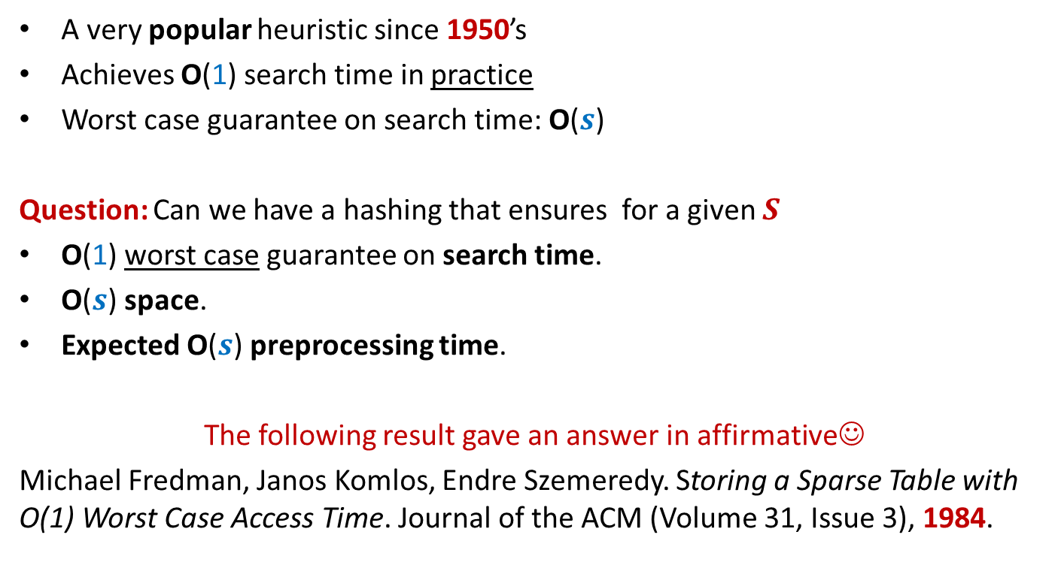
History of Hashing
A very popular heuristic since 1950’s
Achieves O(1) search time in practice
Worst case guarantee on search time: O($s$)
Question: Can we have a hashing that ensures for a given $S$
O(1) worst case guarantee on search time.
O($s$) space.
Expected O($s$) preprocessing time.
The following result gave an answer in affirmative☺
Michael Fredman, Janos Komlos, Endre Szemeredy. Storing a Sparse Table with O(1) Worst Case Access Time. Journal of the ACM (Volume 31, Issue 3), 1984.

Slide 13
Why does hashing work so well in Practice ?

Slide 14
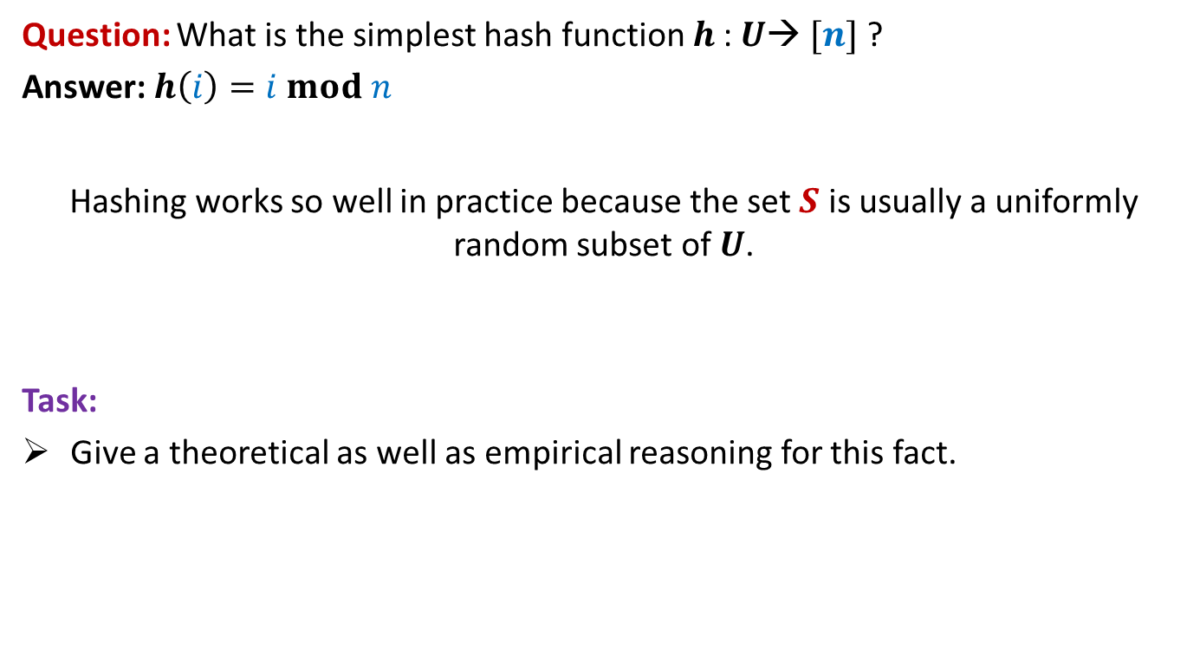
Why does hashing work so well in Practice ?
Question: What is the simplest hash function $h$: $U$→ $[n]$ ?
Answer: $h\left(i\right)=i mod n$
Hashing works so well in practice because the set $S$ is usually a uniformly random subset of $U$.
Task:
Give a theoretical as well as empirical reasoning for this fact.

Slide 15
Approximate Distance Oracles

Slide 16
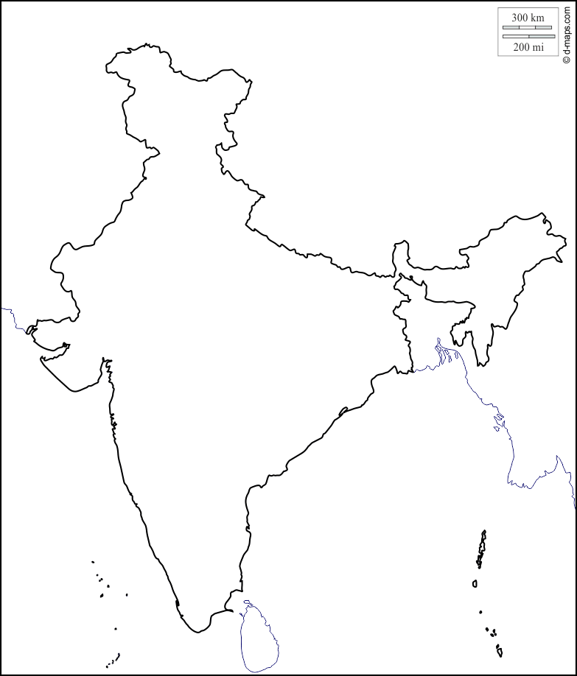

Key insight
$$Kanpur$$

Slide 17





Key insight
$$Rohtak$$
$$Lucknow$$
$$Delhi$$
$$Kanpur$$
$$Fatehpur$$

Slide 18

Idea to achieve subquadratic space
$$V$$

Slide 19


Idea to achieve subquadratic space
Since |$L$| is small, ➔
we can afford to store distance from each $u∈L$ to every other vertex.
From each vertex $u∈V\backslash L$,
store distance to vertices present in its locality
$$L$$
. . . . . . . . . .
$$V$$

Slide 20

Formal notion of locality
$$u$$

Slide 21



Formal notion of locality
$Ball(u,V,L)$= {$x∈V| δ\left(u,x\right)<δ\left(u,L(u)\right)$}
$$L(u)$$
$$u$$
$$Ball(u,V,L)$$

Slide 22

The Idea
Given a graph $G=(V,E)$,
Compute a small set $L$ of Landmark vertices.
From each vertex $u∈V\backslash L$, store distance to vertices present in its locality.
From each vertex $v∈L$, store distance to all vertices in the graph.
Tasks:
What is the formal notion of locality ?
How to retrieve distance from $u$ to a far away vertex ?
What is the guarantee of stretch ?
How to compute the desired set $L$ efficiently ?

